Slide 1
Frontend Development Indroduction
Pregatit de: Radu Sezciuc Data: 23.06.2016

Slide 2
Topics - Frontend introductions - HTML - CSS - JavaScript
Pregatit de: Radu Sezciuc Data: 23.06.2016

Slide 3
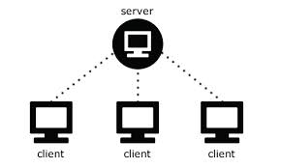
Frontend development
The language used is stored, interpreted and executed on a local client(Web Browser);
Tehnologies:
HTML
CSS
JavaScript
Communicate with Server Side:
Communication through REST.
Representational State Transfer (REST) is a software architecture style consisting of guidelines and best practices for creating scalable web services. In the REST architectural style, data and functionality are considered resources and are accessed using Uniform Resource Identifiers (URIs), typically links on the Web

Slide 4
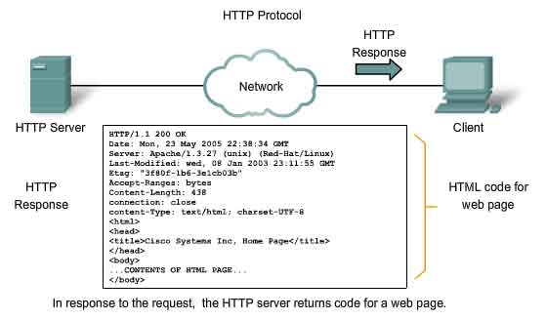
HTTP
RESTful systems typically, but not always, communicate over the Hypertext Transfer Protocol
HTTP is an application protocol for distributed, collaborative, hypermedia information systems.
Used for the communication between the server and the client.

Slide 5
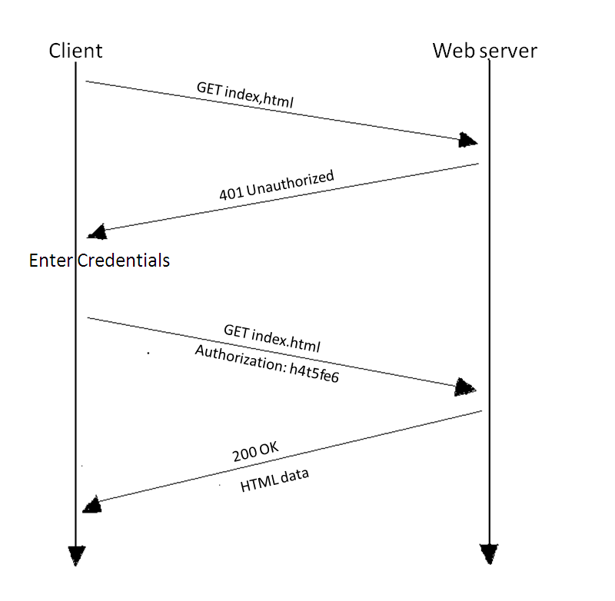
HTTP
HTTP functions as a request-response protocol in the client-server computing model.
A web browser, for example, may be the client and an application running on a computer hosting a web site may be the server.
The client submits an HTTP request message to the server.
The server, which provides resources such as HTML files and other content, or performs other functions on behalf of the client, returns a response message to the client.
The response contains completion status information about the request and may also contain requested content in its message body.

Slide 6
HTTP
Types of requests the client can make to the web server:
GET - Requests a representation of the specified resource
POST - Requests that the server accept the entity enclosed in the request as a new subordinate of the web resource identified by the URI ( uniform resource identifier)
DELETE – deletes the specified resource
PUT - Requests that the enclosed entity be stored under the supplied URI
CONNECT - Converts the request connection to a transparent TCP/IP tunnel
etc

Slide 7
HTML
There are several types of data the server sends to the client
One of them is HTML
HyperText Markup Language
Interpreted by the Web Browser
DOM = Document Object Model
Nested structure formed by elements and attributes

Slide 8
HTML
Elements structure:
DOCTYPE
html
head
body
<!DOCTYPE html>
<html>
<head>
</head>
<body
</body>
</html>

Slide 9
HTML
HEAD element:
Elements for page description;
Elements for loading external resources;
Elements:
<title>
<link>
<style>
<script>
<meta>

Slide 10
HTML
BODY element:
Elements displayed in browser
Elements:
<div>
<p>
<table>
…

Slide 11
HTML
HTML attributes:
Indicators that offer additional information for elements;
Key/value pairs;
Ex:
<a href=“http://www.google.com”>Link</a>
<input type=“text”/>
<table border=“1”>

Slide 12
CSS
CSS:
Cascading Style Sheets
Language for formatting HTML elements
Declaration:
Inside HTML document using ‘style’ attribute or ‘<style>’ element;
External files loaded inside the HTML page;

Slide 13
JavaScript
Dynamic programming language;
Interpreted and executed on Client Side;
Implements EcmaScript (ECMAScript is the scripting language standardized by Ecma International. The language is widely used for client-side scripting on the Web, in the form of several well-known implementations such as JavaScript, JScript and ActionScript.)
Interacts with user actions;
Asynchronous communication (is transmission of data, generally without the use of an external clock signal, where data can be transmitted intermittently rather than in a steady stream)
Document manipulation;

Slide 14
Difference between Javascript and C++/Java
Even though their names suggest that Java and JavaScript must be related somehow, it is just not true.
JavaScript is an interpreted computer programming language, not a compiled one
The main difference between Java and JavaScript is that while Java is a programming language, JavaScript is scripting language.
It is a prototype-based scripting language that is dynamic, weakly typed C++ is a safe typed, multi-paradigm and a compiled programming language.

Slide 15
JavaScript
Adding JavaScript on page:
Inside HTML file;
Using external scripts loaded inside HTML page;

Slide 16
JavaScript
Variables:
No type declaration;
In computer science, type safety is the extent to which a programming language discourages or prevents type errors. Javascript isn’t type safe.
Declared using ‘var’ keyword;
Scope:
Local:
Declared inside a function;
Function parameters;
Global:
Declared outside a function;
Declared inside a function but without the ‘var’ keyword;

Slide 17
JavaScript
Data types:
String
Number
Boolean
Undefined
Null
Array
Object

Slide 18
JavaScript
Array declaration:
var myArray = new Array(“a”, “b”, 1, 2);
var myArray = [‘a’, ‘b’, 1, 2];

Slide 19
JavaScript
Object declaration:
var myObj = new Object();
var myObj = {};
Using a constructor function:
function MyObject() {};
var myObj = new MyObject();

Slide 20
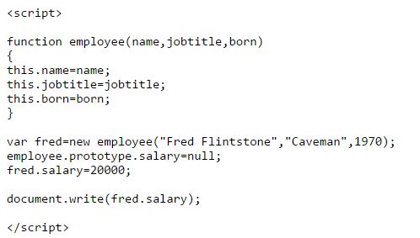
Prototype
The prototype property allows you to add properties and methods to an object.

Slide 21

JavaScript
Accesing object properties:
myObj.myProp;
myObj[“myProp”];
var myKey = “myProp”; myObj[myKey];
Looping through an object:

Slide 22
JavaScript
Functions:
Declaration:
function myF(params…) {… return value;};
var myF = function(params…) {… return value;}; → anonymous function
var myF = function myF(params){… return value;}; -> named function
Calling:
myF(“value”,…);

Slide 23
JavaScript
HTML events:
Triggered on user actions;
Can call JavaScript Functions;
Ex: onclick, onmouseover, onkeypress,….

Slide 24
Workshop: Basic JavaScript Application

Slide 25
Questions?

Slide 26
Thank you!

